Slide 1
Ultimate Warrior
An effort to whitewash the prejudiced past of Jim Hellwig
2019-03-20
CS795/895
Puneeth Bikkasandra
Old Dominion University

Slide 2
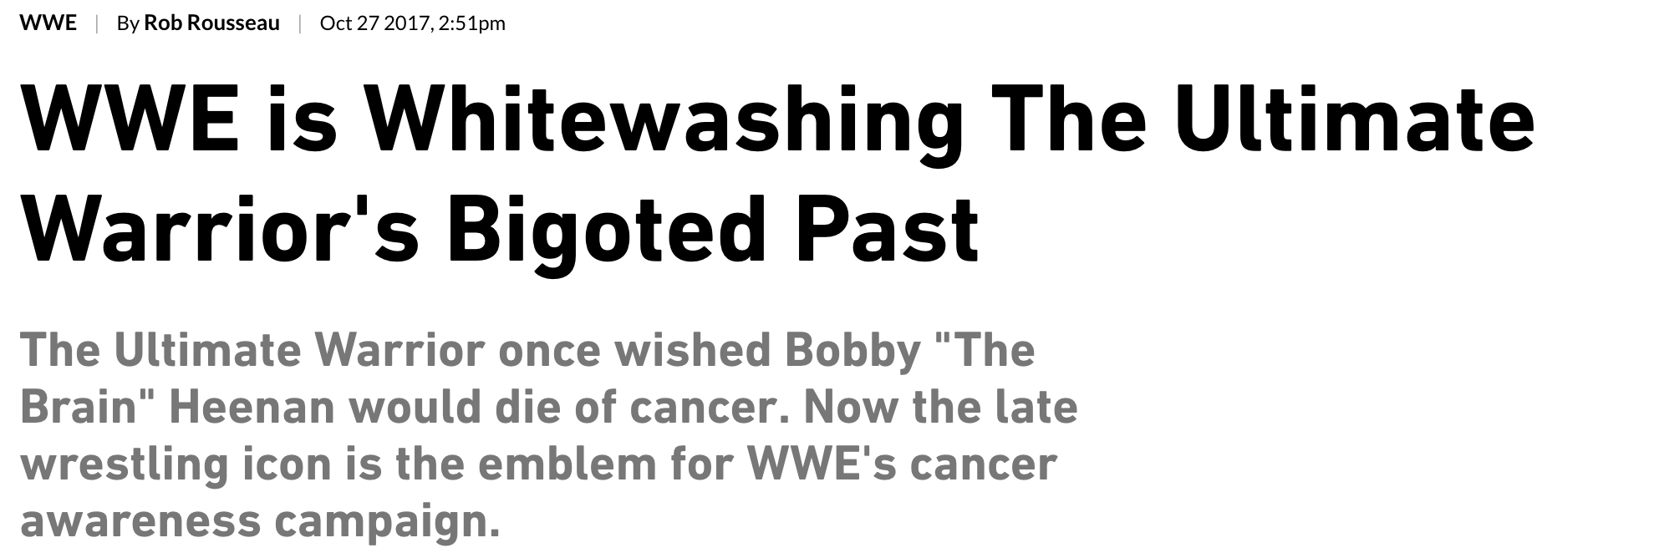
The following study is based on:
Source: https://sports.vice.com/en_us/article/59y3nb/wwe-is-whitewashing-the-ultimate-warriors-bigoted-past

Slide 3
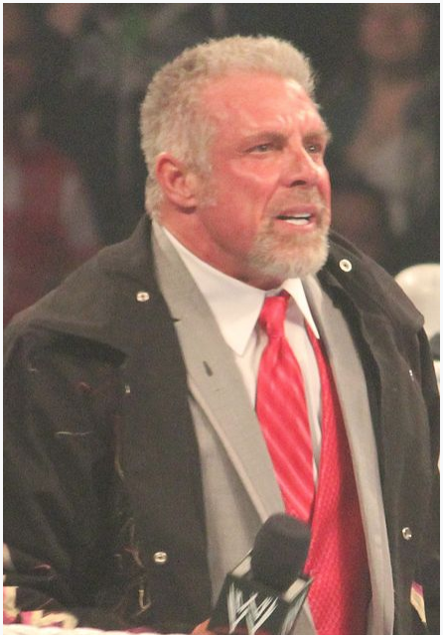
Jim Hellwig (The Ultimate Warrior)
Aged 54: 06/16/1959 - 04/08/2014
Body Builder (1984)
Professional Wrestling
Debut in WWF (1987)
Semi-retirement from WWF
Comic Writer - ‘Warrior’
Motivational Speaker
Authored blogs (known for racist comments)
WWE Hall of Fame (04/05/2014)
Dies of a heart attack on 04/08/2014
https://en.wikipedia.org/wiki/The_Ultimate_Warrior

Slide 4
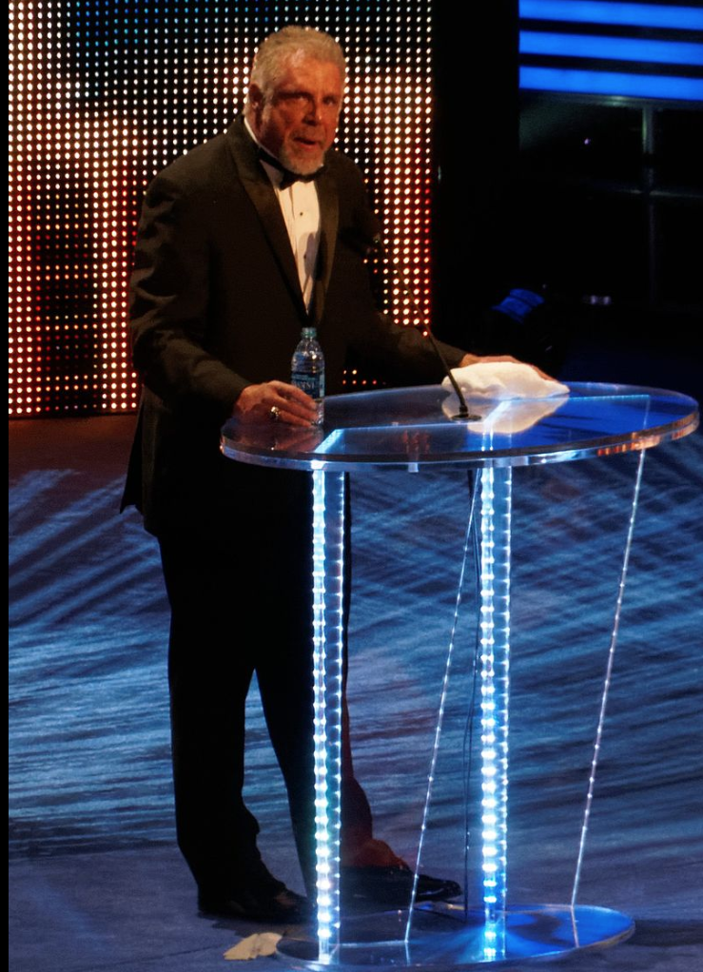
Centerpiece of WWE philanthropy Initiatives
An award named after as “Warrior Award”
#UnleashYourWarrior campaign with
Susan G. Komen Foundation
Breast Cancer Awareness programs
WWE Hall of Fame, 2014
https://sports.vice.com/en_us/article/59y3nb/wwe-is-whitewashing-the-ultimate-warriors-bigoted-past

Slide 5
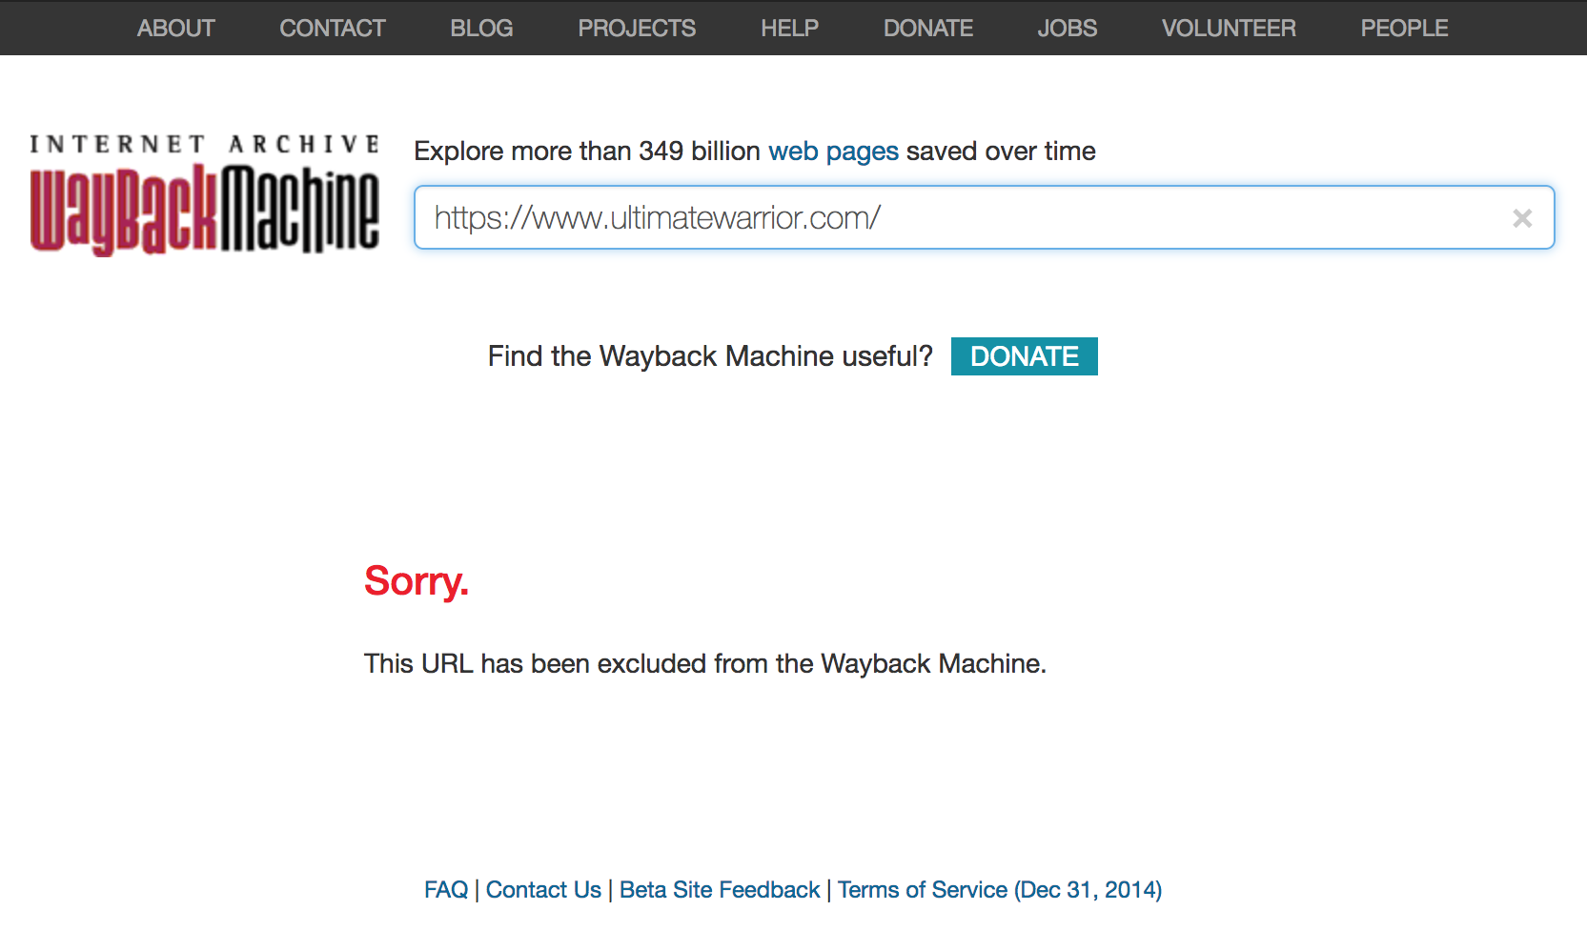
No Copies in Internet Archive!
https://gizmodo.com/when-the-internet-archive-forgets-1830462131

Slide 6
Current robots.txt of the Blog
User-agent: *
Disallow: / fire /
Disallow: / bo /
Disallow: /editor.jsp
Disallow: / noflashhtml
Disallow: / siteBackHtml
Disallow: / Wix /
Disallow: / wixpress /
Disallow: / wixdemo /
Disallow: / Wix editor /
Disallow: /editor2.jsp
Disallow: / flash /
Disallow: / flash-templates /
Disallow: / jobs / seo /
Disallow: / website template / view / flash /
Disallow: / facebook-templates /
Disallow: / facebook / templates /
Disallow: / website / templates / flash /
Disallow: /favicon.ico
Sitemap: https://www.ultimatewarrior.com/sitemap.xml
http://www.ultimatewarrior.com/robots.txt

Slide 7
WWE was behind taking down copies at IA
‘Rob Rousseau’ article was published at “Vice Sports” on Oct 27, 2017
WWE Spokespersons denied the involvement
Internet Archive confirms DMCA takedown request from WWE on Oct 29, 2017.
Copies at IA were taken down on Oct 29, 2017.
DMCA stands for Digital Millennium Copyright Act.
“A DMCA notice informs a company, web host, search engine, or internet service provider that they are hosting or linking to material that infringes on a copyright. The party that receives the notice should take down the material in question as soon as possible. If the site owner doesn't comply, the ISP can forcibly remove the content”
https://gizmodo.com/when-the-internet-archive-forgets-1830462131
https://www.upcounsel.com/dmca-notice

Slide 8
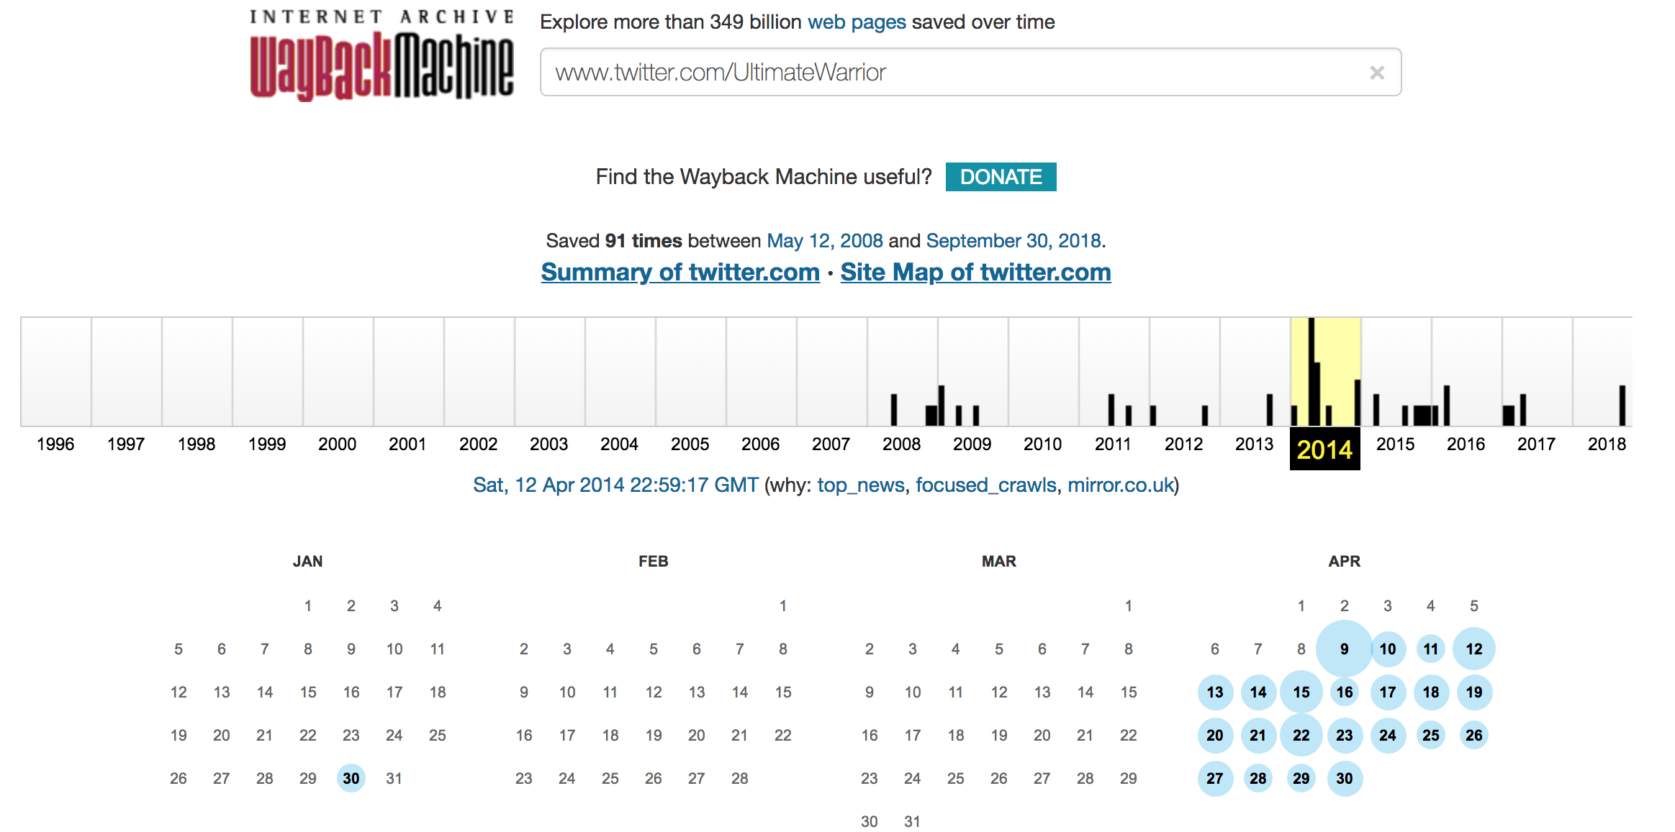
Activeness on Twitter

Slide 9
Blog article on ‘Hurricane Katrina’ deleted!
curl --silent http://memgator.cs.odu.edu/timemap/link/http://www.ultimatewarrior.com/Posts/10032005-NewOrleans.html | grep datetime | uniq -c
Not Archived!
URL Source: https://sports.vice.com/en_us/article/59y3nb/wwe-is-whitewashing-the-ultimate-warriors-bigoted-past

Slide 10
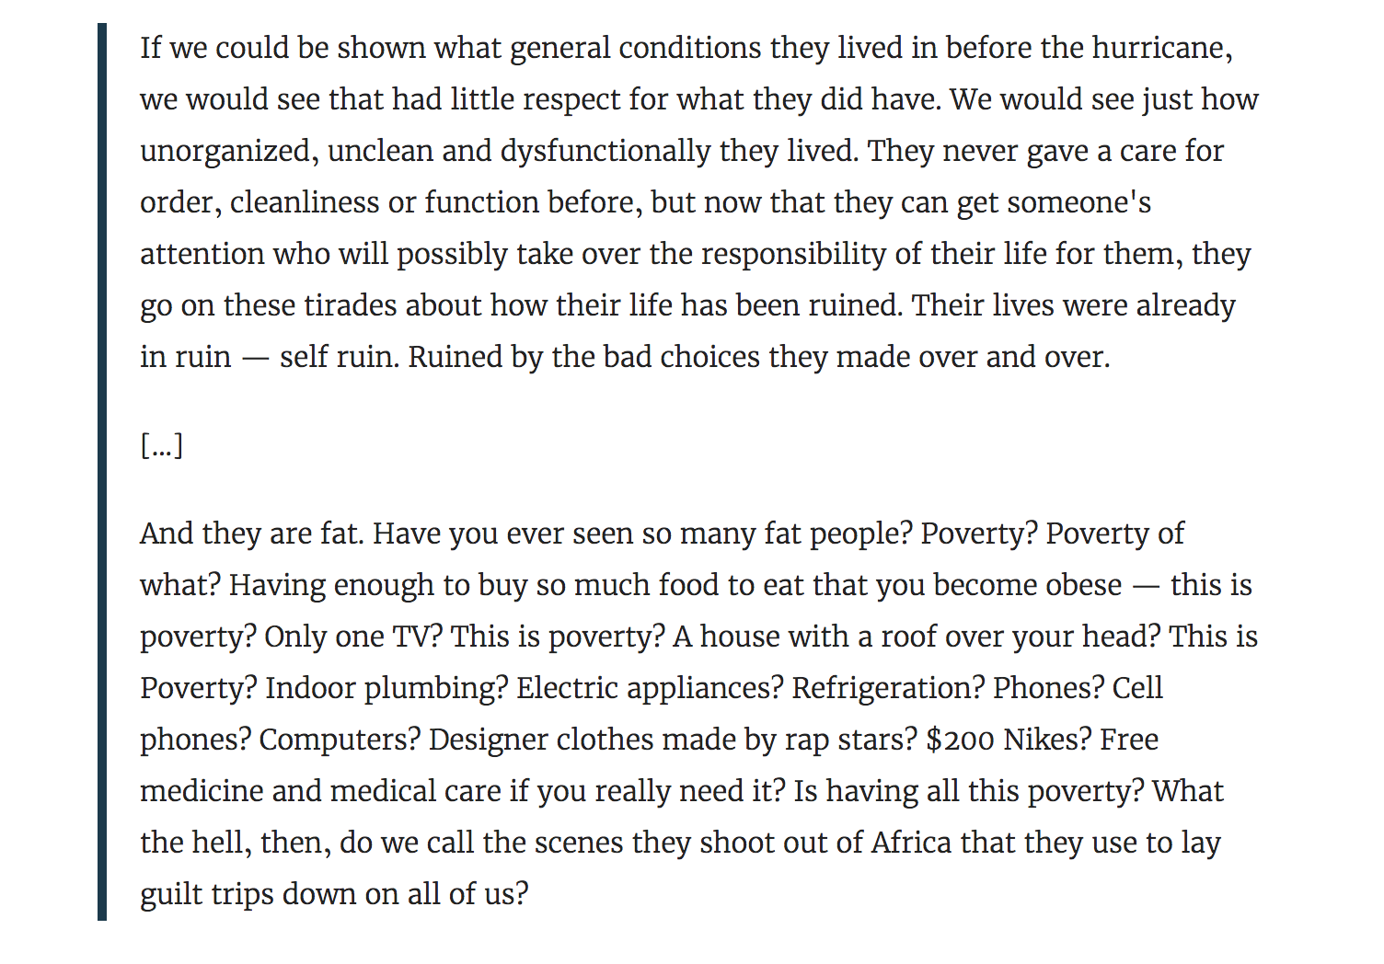
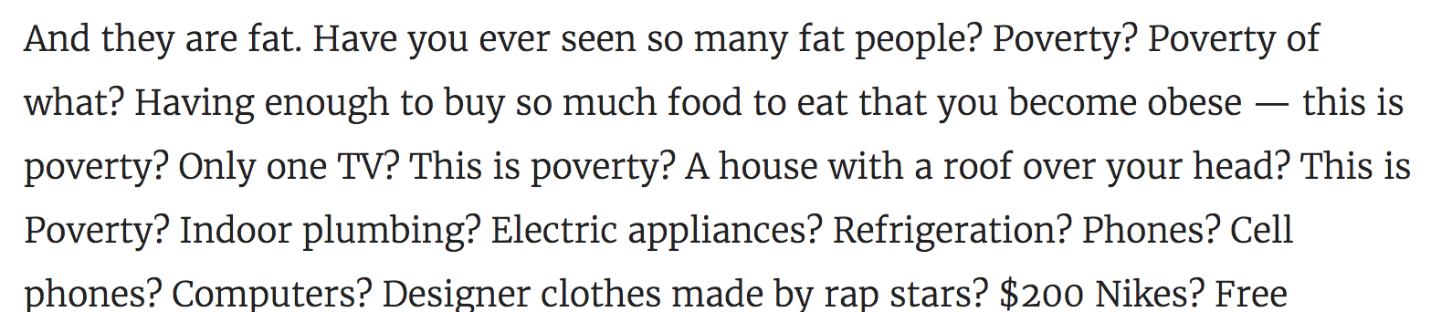
Comments on ‘Hurricane Katrina’ victims
https://deadspin.com/the-ultimate-warrior-was-an-insane-dick-1561275496

Slide 11
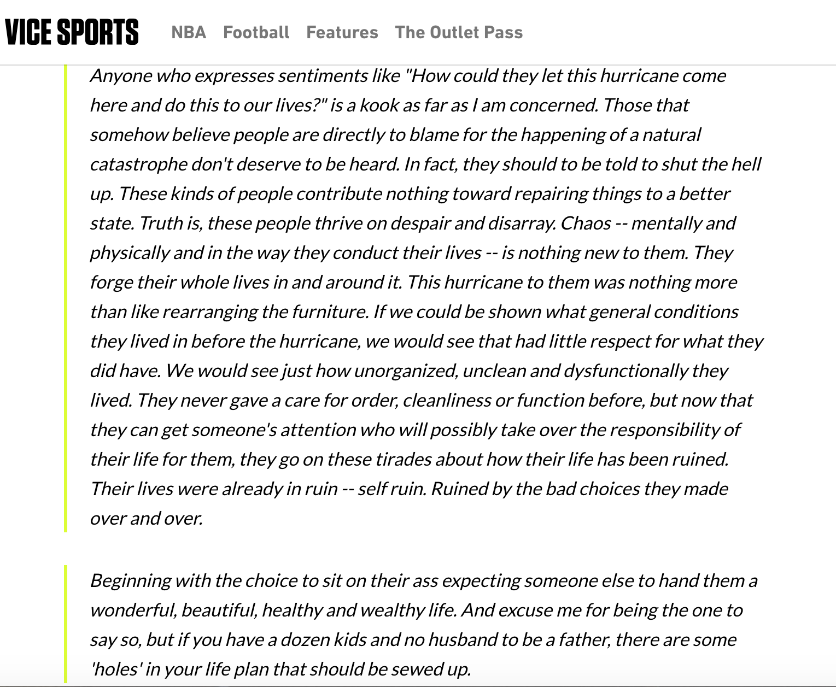
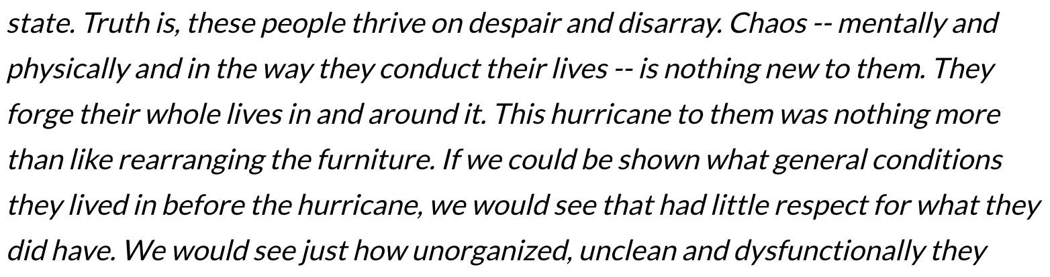
Few excerpts from cited article:
https://sports.vice.com/en_us/article/59y3nb/wwe-is-whitewashing-the-ultimate-warriors-bigoted-past

Slide 12
Comment on ‘Martin Luther King day’
curl --silent http://memgator.cs.odu.edu/timemap/link/http://www.ultimatewarrior.com/warriorsmachete/?p=28 | grep datetime | uniq -c
1 <http://archive.md/20130105071218/http://www.ultimatewarrior.com/warriorsmachete/?p=28>; rel="first last memento"; datetime="Sat, 05 Jan 2013 07:12:18 GMT",
URL Source: https://sports.vice.com/en_us/article/59y3nb/wwe-is-whitewashing-the-ultimate-warriors-bigoted-past

Slide 13
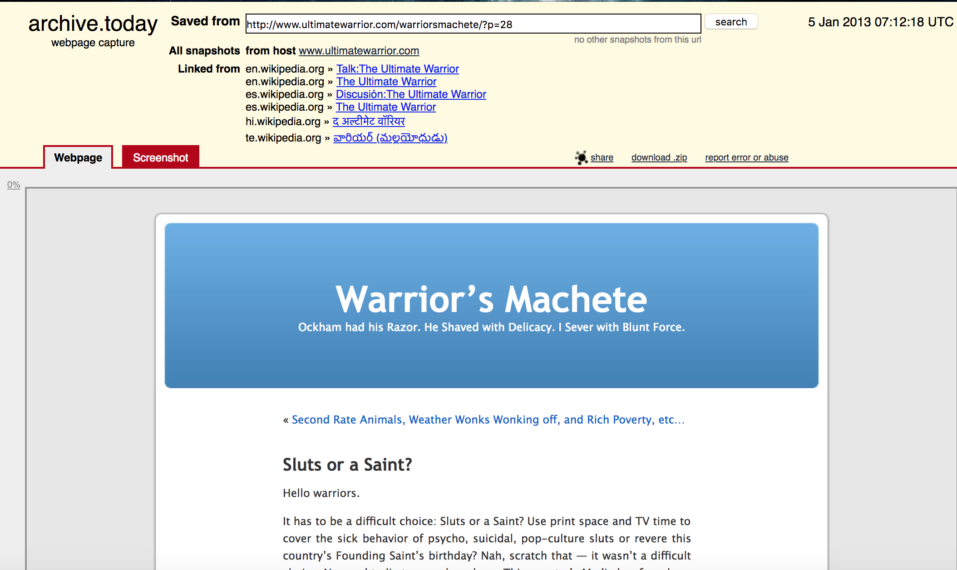
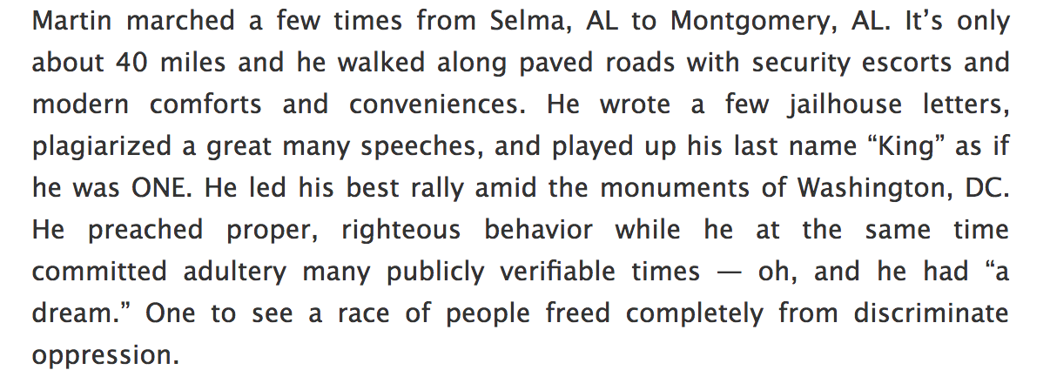
Excerpts from blog: Warrior’s Machete
http://archive.is/bOchy

Slide 14
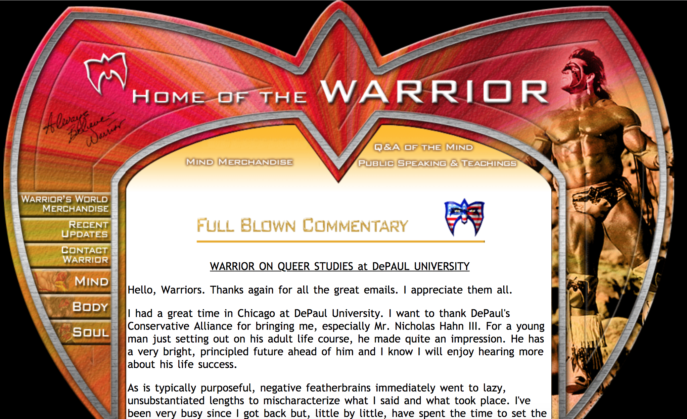
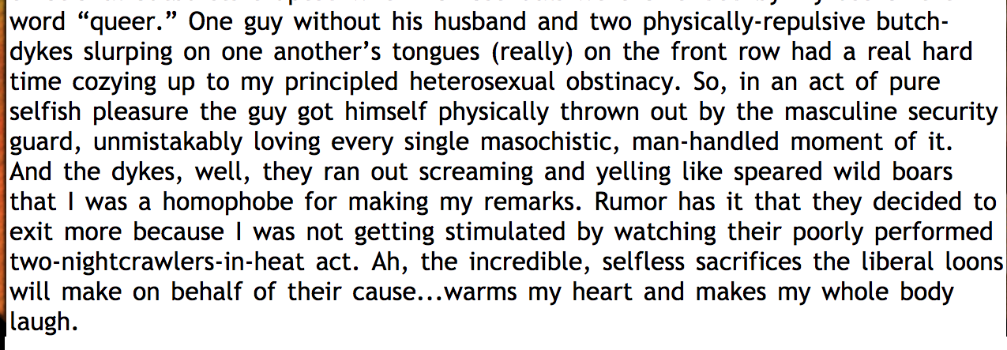
Speech - Conservative alliance event- Depaul University
http://archive.is/wpqko

Slide 15
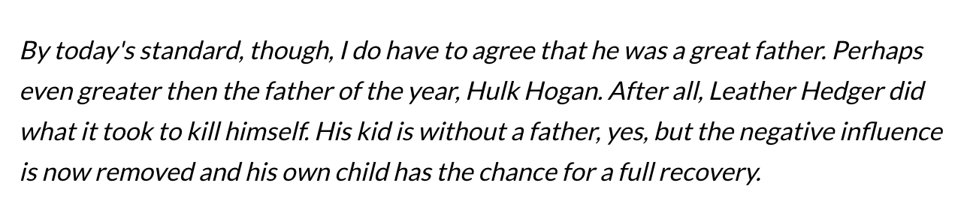
Comments on death of Heath Ledger
(For his role as a homosexual character in the film Brokeback Mountain)
Copy at archive (archive.is) did not render the page.
https://sports.vice.com/en_us/article/59y3nb/wwe-is-whitewashing-the-ultimate-warriors-bigoted-past

Slide 16
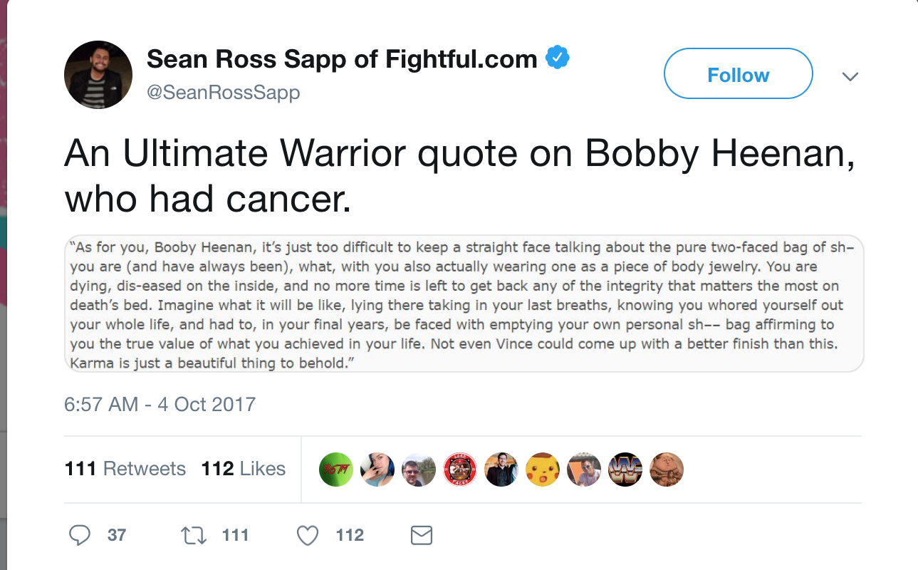
Comments on Former Announcer: Bobby Heenan
https://twitter.com/SeanRossSapp/status/915387938934059010
https://sports.vice.com/en_us/article/59y3nb/wwe-is-whitewashing-the-ultimate-warriors-bigoted-past

Slide 17
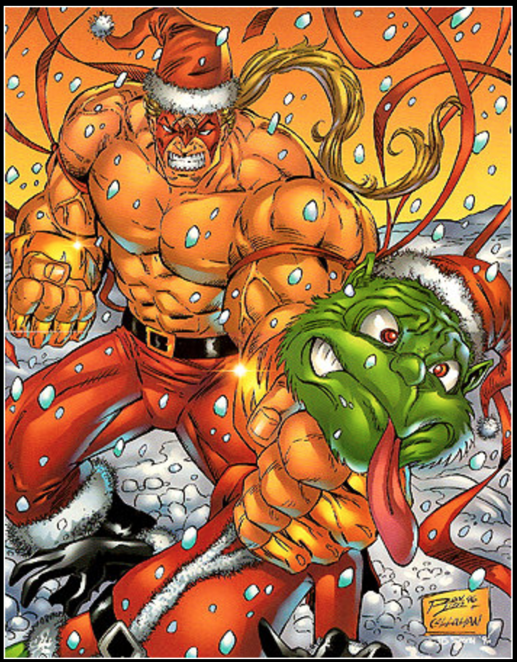
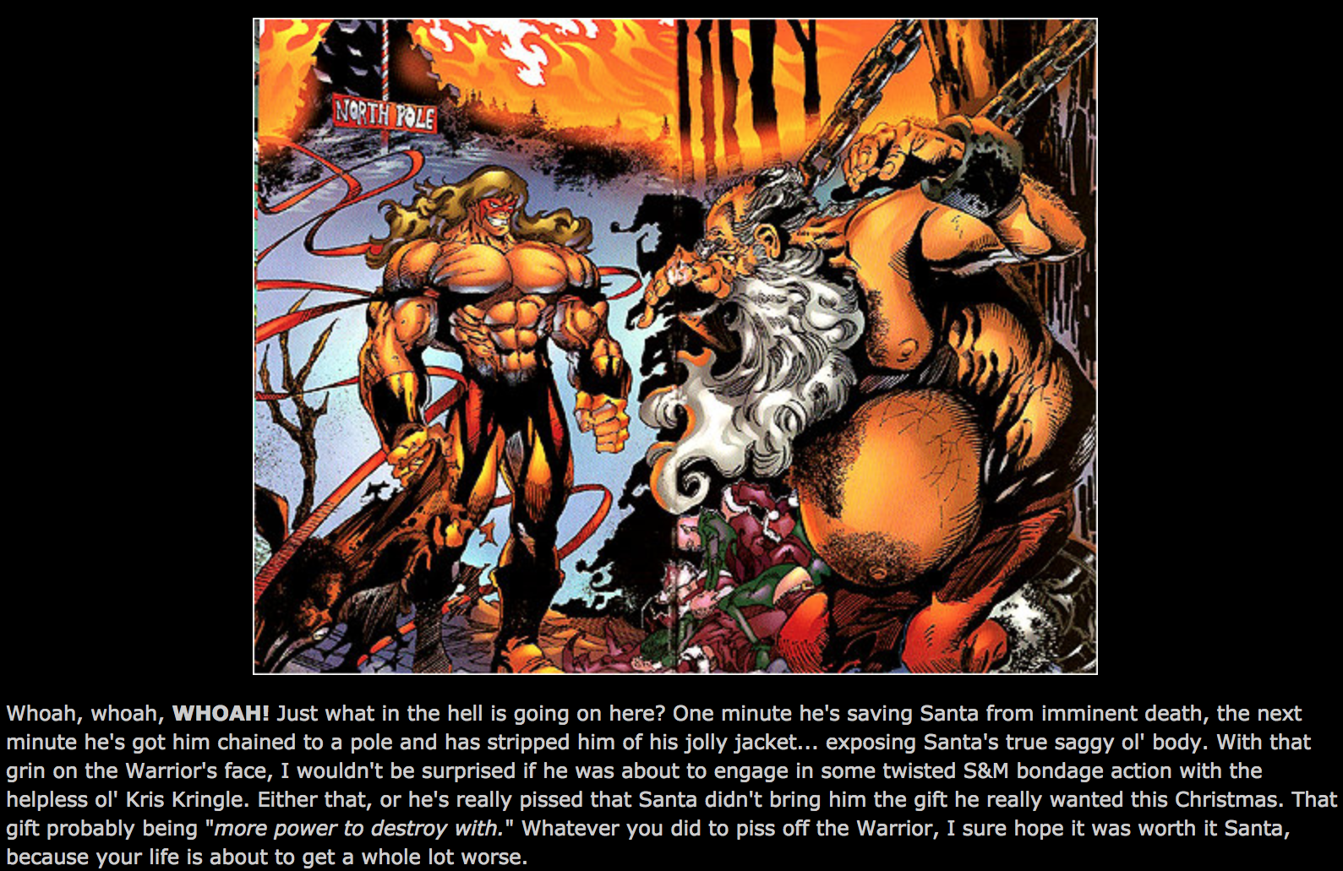
‘Warrior’ Comic
http://www.i-mockery.com/minimocks/warrior-xmas/default.php

Slide 18
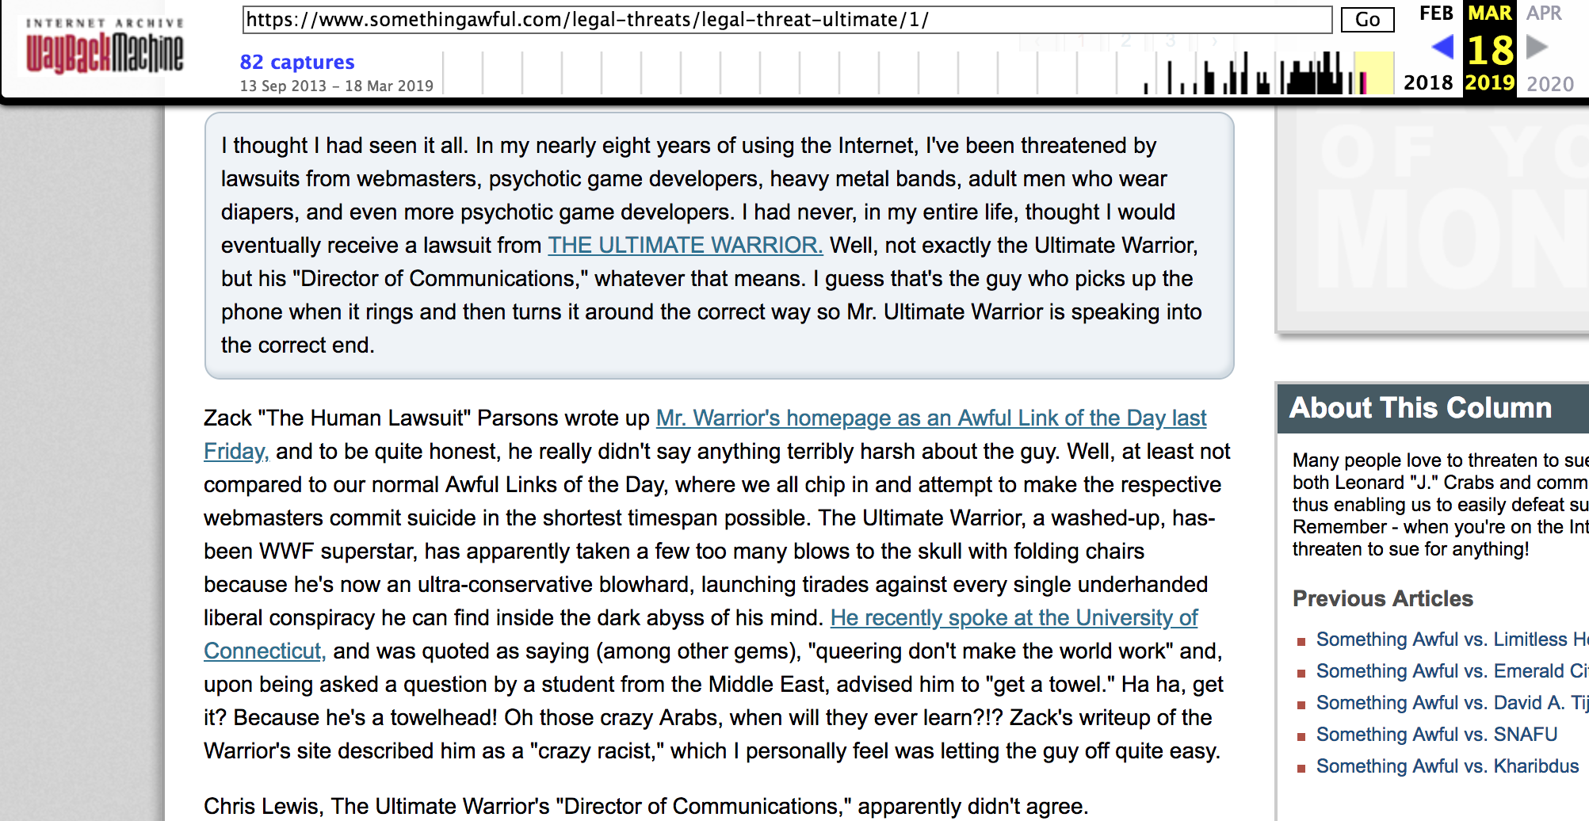
Somethingawful (vs) Ultimate Warrior
https://web.archive.org/web/20190318173613/https://www.somethingawful.com/legal-threats/legal-threat-ultimate/1/

Slide 19
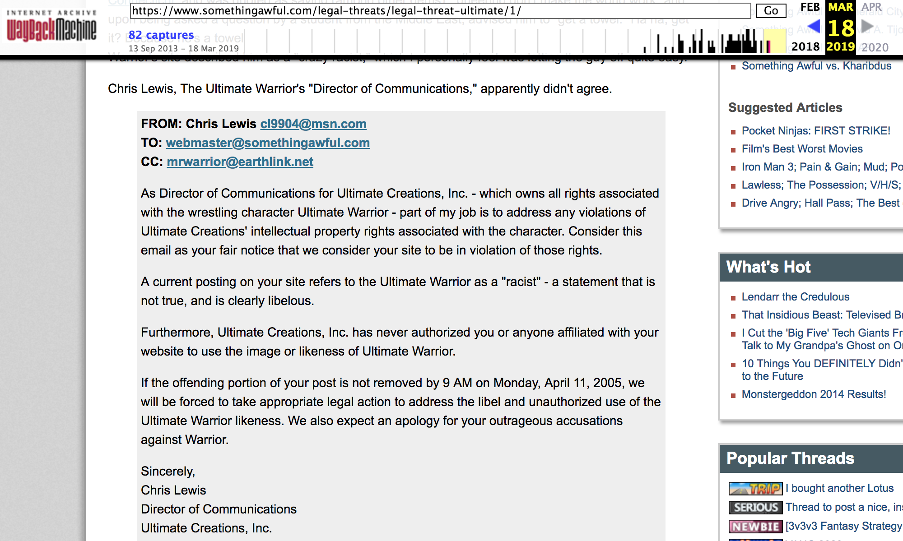
Notice to drop the post
https://web.archive.org/web/20190318173613/https://www.somethingawful.com/legal-threats/legal-threat-ultimate/1/

Slide 20
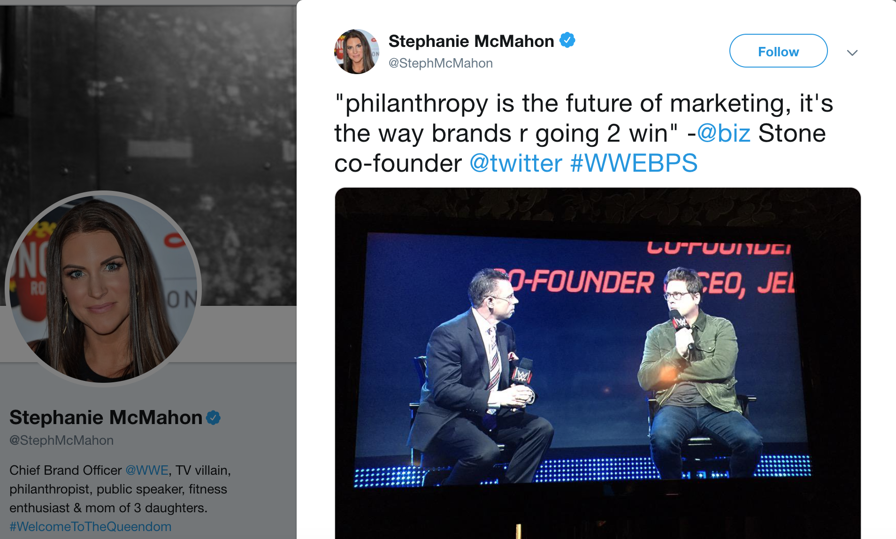
From the desk of Chief Branding Officer
Creating Branding through:
#UnleashYourWarrior and
Breast Cancer Campaigns
https://twitter.com/StephMcMahon/status/581881800659591168?ref_src=twsrc%5Etfw%7Ctwcamp%5Etweetembed%7Ctwterm%5E581881800659591168&ref_url=https%3A%2F%2Ftwitter.com%2FStephMcMahon%2Fstatus%2F581881800659591168

Slide 21
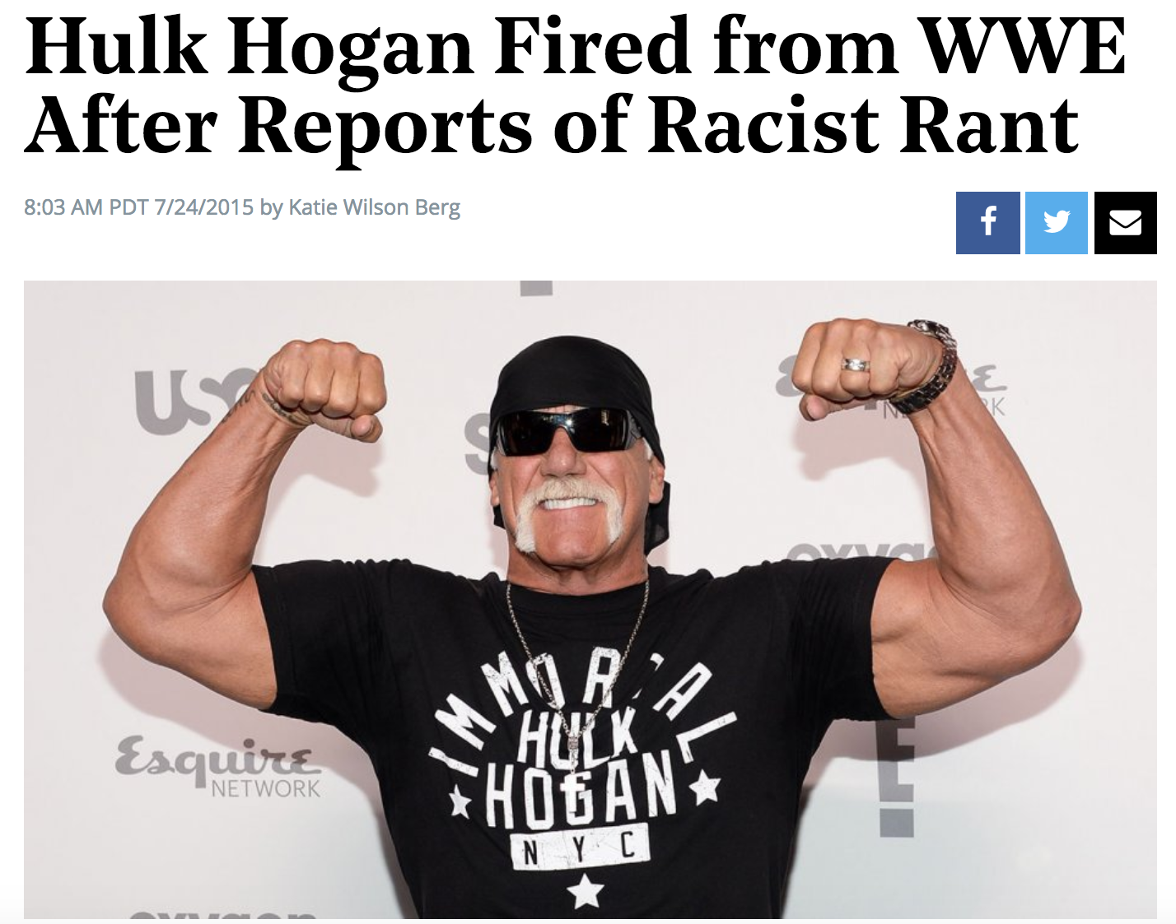
Banished for ugly comments!
Jim Hellwig was dead by this time.
https://www.hollywoodreporter.com/news/hulk-hogan-fired-wwe-reports-810894

Slide 22
Take Away:
Philanthropy appears to be a new gimmick in marketing, as ‘Jim Hellwig’ did not pay for his series of racist comments.
A serious example for need for multiple web archives.

